Slide 1
Introduction to ASP.NET MVC 5 & ASP.NET WEB API
Trainer: Cao Van Loi

Slide 2
Course Objectives
ASP.NET MVC 5
Introducing ASP.NET MVC 5
Understanding the MVC Pattern
Create your first ASP.NET MVC 5 Application
ASP.NET WEB API
Introducing ASP.NET WEB API
Create your first ASP.NET WEB API project

Slide 3
Agenda
ASP.NET MVC 5
What's wrong with ASP.NET Web Forms?
What is MVC?
Understanding the MVC Pattern
What’s Razor?
What are the benefits of Razor?
Routing
Build the First MVC Application
Q&A
ASP.NET WEB API
What's ASP.NET WEB API?
Comparison between WCF Service and Web API
Build the First WEB API project
Q&A

Slide 4
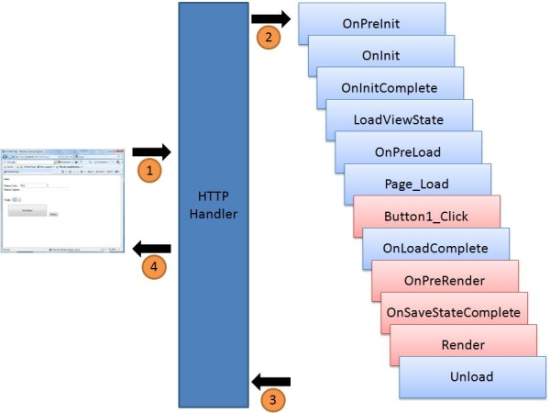
What’s wrong with ASP.NET Web Forms?
View State weight
Page life cycle
False sense of separation of concerns
Limited control over HTML
Low testability
ASP.NET Page Life Cycle

Slide 5
What’s MVC?
The name of a methodology or design pattern
Using for successfully and efficiently relating the user interface to underlying data models
The MVC pattern is widely used in program development with programming languages such as Java, Smalltalk, C, and C++

Slide 6
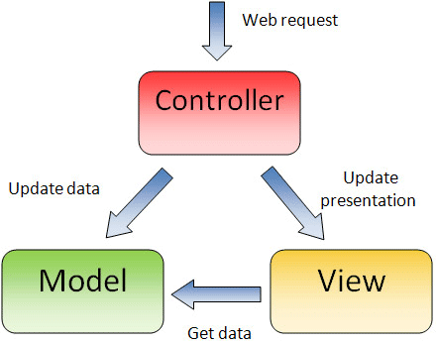
Understanding the MVC pattern

Slide 7
The Controller
a C# or VB.NET class which inherits system.mvc.controller
a heart of the entire MVC architecture
can access and use model class to pass data to views
uses ViewData/ViewBag to pass any data to view
accepts params in order: form values, route definition and query string

Slide 8
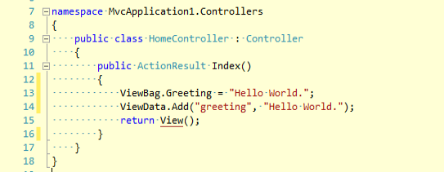
The Controller (cont)

Slide 9
The View
ASPX page without having a code behind file
All page specific HTML generation and formatting can be done inside view
Can use Razor/Server tag to rendering data to View
A request to view can be made only from a controller’s action method

Slide 10
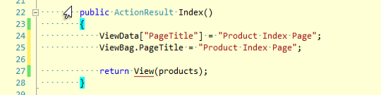
ViewData and ViewBag
ViewData is a dictionary of objects
ViewBag is a dynamic property
ViewData requires typecasting for complex data type and check for null values to avoid error.
ViewBag doesn’t require typecasting for complex data type.

Slide 11
ViewData and ViewBag
ViewData | ViewBag | TempData
It is Key-Value Dictionary collection | It is a type object | It is Key-Value Dictionary collection
ViewData is a dictionary object and it is property of ControllerBase class | ViewBag is Dynamic property of ControllerBase class. | TempData is a dictionary object and it is property of controllerBase class.
ViewData is Faster than ViewBag | ViewBag is slower than ViewData | NA
ViewData is introduced in MVC 1.0 and available in MVC 1.0 and above | ViewBag is introduced in MVC 3.0 and available in MVC 3.0 and above | TempData is also introduced in MVC1.0 and available in MVC 1.0 and above.
ViewData also works with .net framework 3.5 and above | ViewBag only works with .net framework 4.0 and above | TempData also works with .net framework 3.5 and above
Type Conversion code is required while enumerating | In depth, ViewBag is used dynamic, so there is no need to type conversion while enumerating. | Type Conversion code is required while enumerating
Its value becomes null if redirection has occurred. | Same as ViewData | TempData is used to pass data between two consecutive requests.
It lies only during the current request. | Same as ViewData | TempData only works during the current and subsequent request

Slide 12
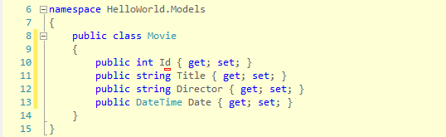
This is a “Two Content” slide
MVC model is basically a C# or VB.NET class
A model is accessible by both controller and view
A model can be used to pass data from Controller to view
A view can use model to display data in page

Slide 13
What’s Razor?
Razor is the name of the new view engine which introduced in MVC 3
The Razor syntax is a template markup syntax, centered on the @ symbol
What are the benefits of Razor?
Compact, Expressive, and Fluid
Easy to Learn
Works with any Text Editor
Has great Intellisense
Unit Testable

Slide 14
Syntax/Sample | Razor | Web Forms Equivalent (or remarks)
Code Block | @{ int x = 123; string y = "because."; } | <% int x = 123; string y = "because."; %>
Expression (Html Encoded) | <span>@model.Message</span> | <span><%: model.Message %></span>
Expression (Unencoded) | <span> @Html.Raw(model.Message) </span> | <span><%= model.Message %></span>
Combining Text and markup | @foreach(var item in items) { <span>@item.Prop</span> } | <% foreach(var item in items) { %> <span><%: item.Prop %></span> <% } %>
Mixing code and plain text (alternate) | @if (foo) { @:Plain Text is @bar } | Same as above

Slide 15
Syntax/Sample | Razor | Web Forms Equivalent (or remarks)
Code Block | @{ int x = 123; string y = "because."; } | <% int x = 123; string y = "because."; %>
Expression (Html Encoded) | <span>@model.Message</span> | <span><%: model.Message %></span>
Expression (Unencoded) | <span> @Html.Raw(model.Message) </span> | <span><%= model.Message %></span>
Combining Text and markup | @foreach(var item in items) { <span>@item.Prop</span> } | <% foreach(var item in items) { %> <span><%: item.Prop %></span> <% } %>
Mixing code and plain text (alternate) | @if (foo) { @:Plain Text is @bar } | Same as above

Slide 16
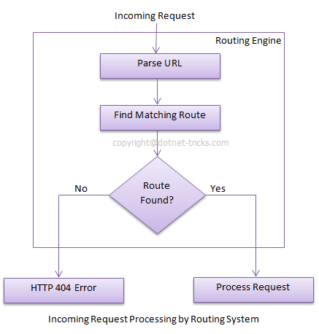
ROUTING IN MVC

Slide 17
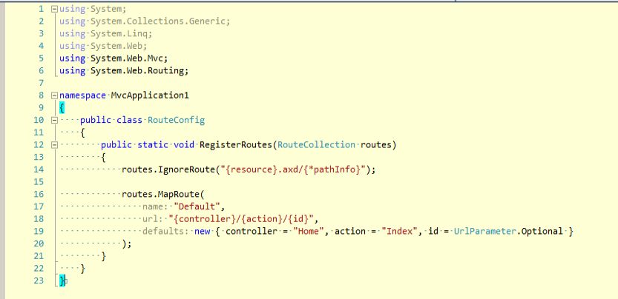
ROUTING IN MVC

Slide 18
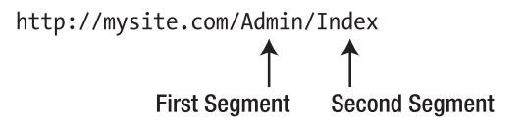
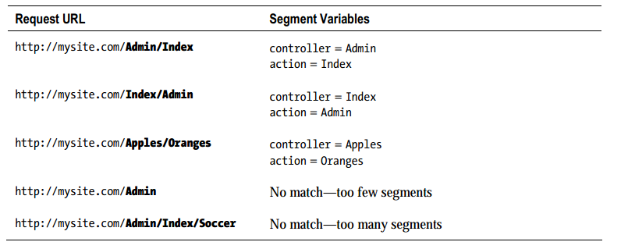
ROUTING IN MVC
URLs can be broken down into segments
The URL pattern does this: {controller}/{action}

Slide 19
BUILD THE FIRST MVC APPLICATION
http://www.asp.net/mvc/tutorials/mvc-5/introduction/getting-started

Slide 20
Questions & Answer

Slide 21
Course Objectives
ASP.NET MVC 5
Introducing ASP.NET MVC 5
Understanding the MVC Pattern
Create your first ASP.NET MVC 5 Application
ASP.NET WEB API
Introducing ASP.NET WEB API
Create your first ASP.NET WEB API project

Slide 22
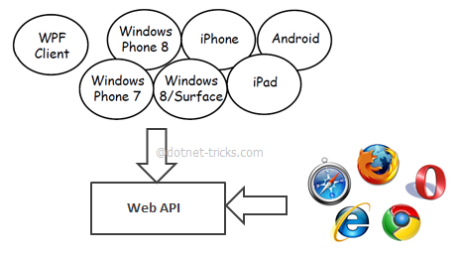
WHAT’S ASP.NET API?
An HTTP Service
ASP.NET Web API is a framework for building web APIs on top of the .NET Framework
Uses HTTP as an Application protocol, not a transport protocol
We can build ASP.NET Web API with the MVC pattern

Slide 23
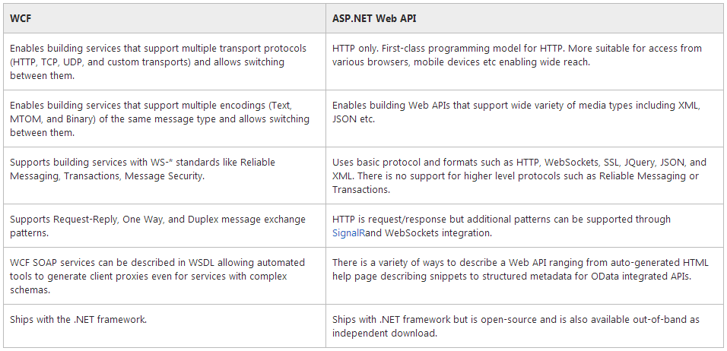
Comparison between WCF and Web API

Slide 24
Build your first ASP.NET Web API project
http://www.asp.net/web-api/overview/getting-started-with-aspnet-web-api/tutorial-your-first-web-api

Slide 25
Questions & Answer

Slide 26
Thank you!

Slide 27
Revision History
Date | Version | Description | Updated by | Reviewed and Approved By
Aug 2014 | 1.0.0 | First draft | Dan Cao
5 Oct 2017 | 1.0.1 | Applied new DXC template Edit following items: Change font size Add title for slide 16, 17 Add new slide 20. | Loi Cao

